Slide 1
There’s No Good Way to Pay for Property Tax Repeal
Jared Walczak, Tax Foundation
jmw@taxfoundation.org

Slide 2
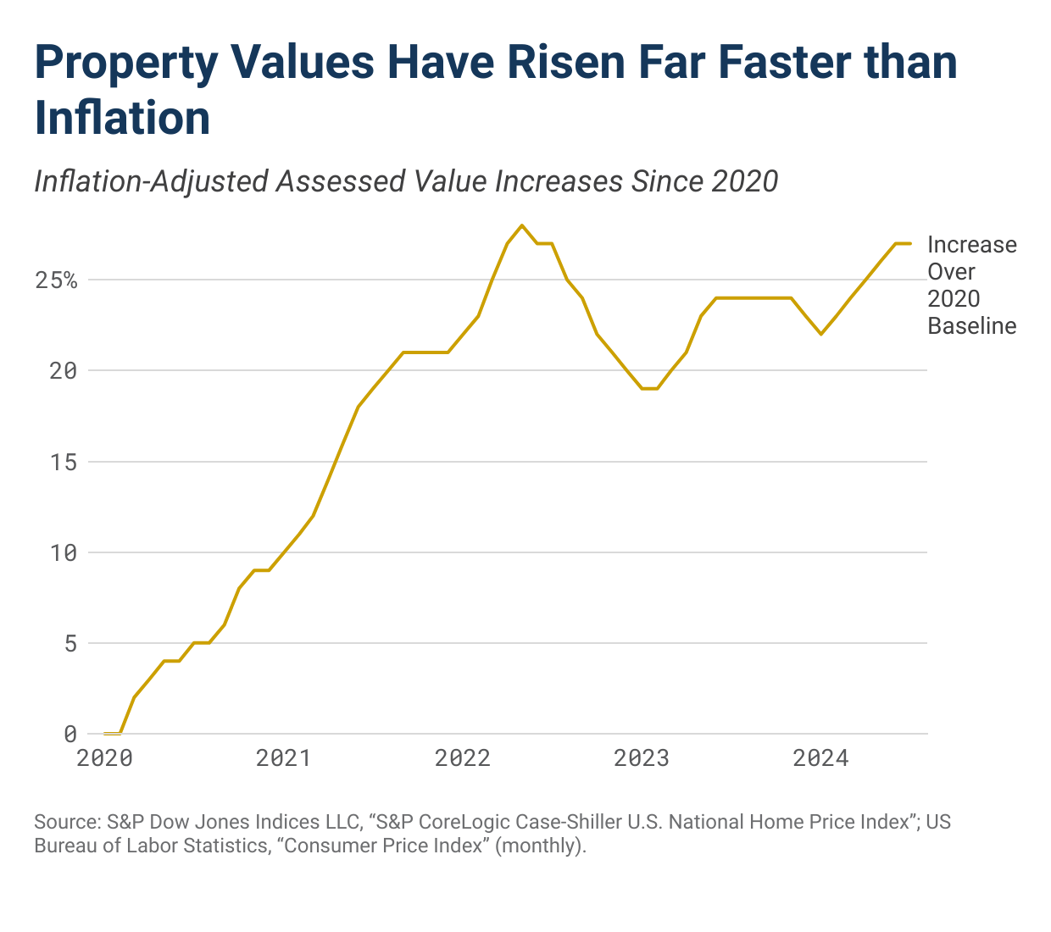

Slide 3
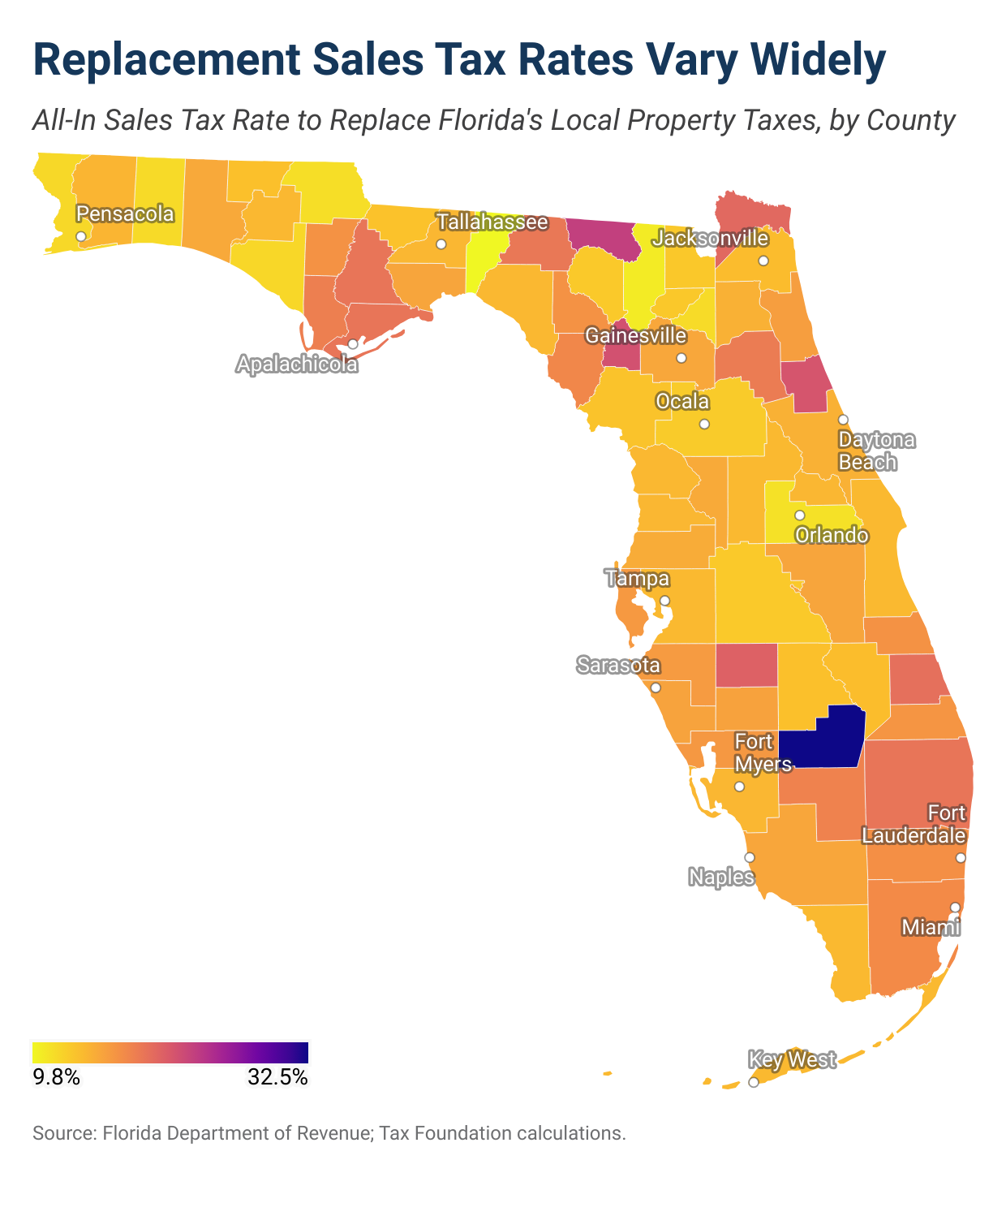

Slide 4
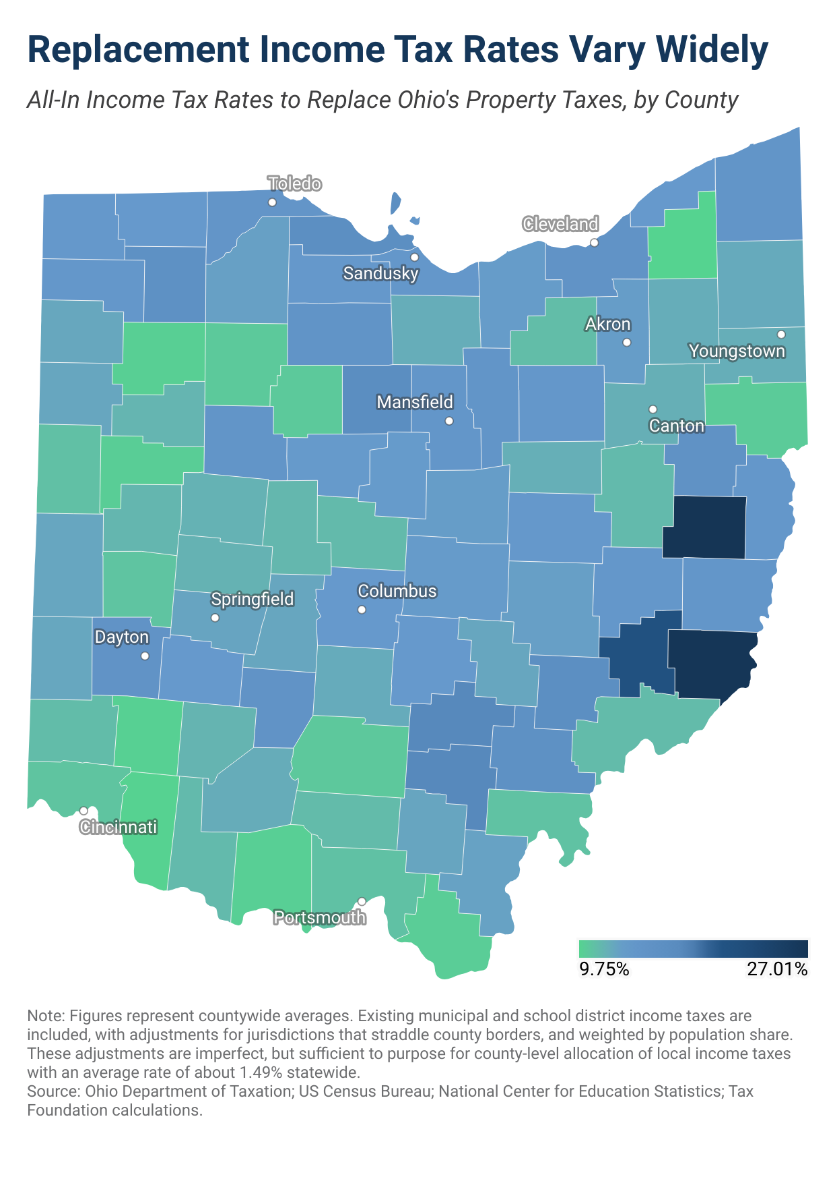

Slide 5
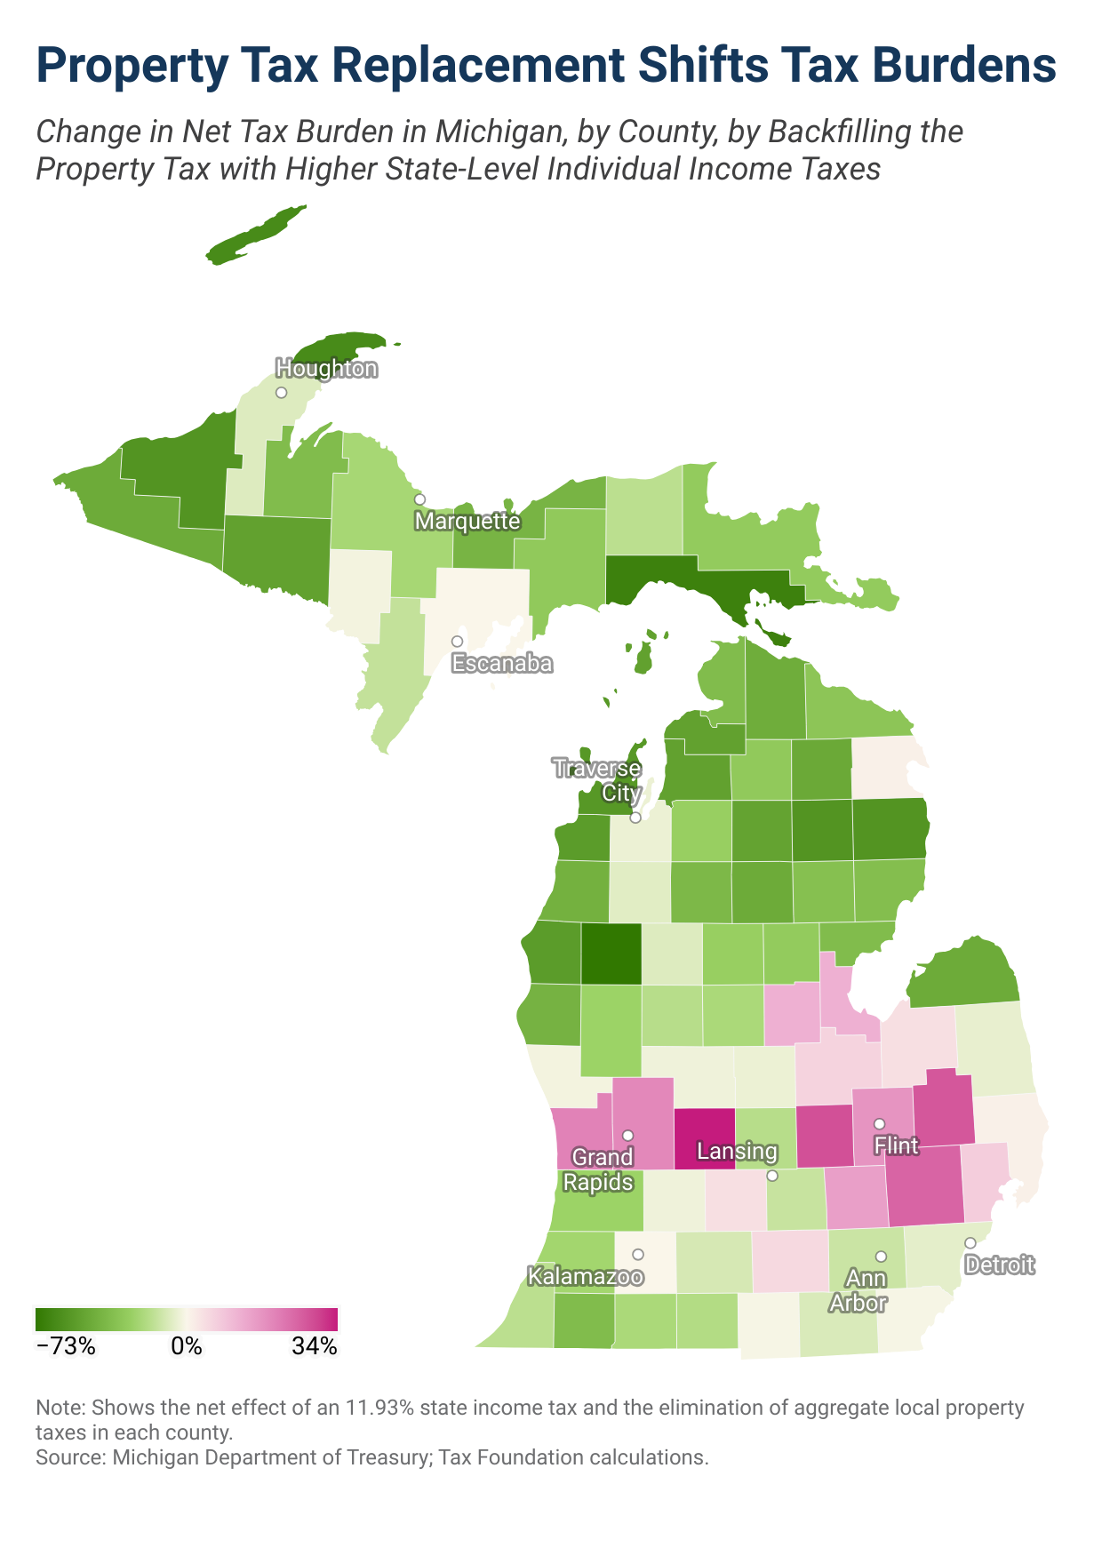

Slide 6
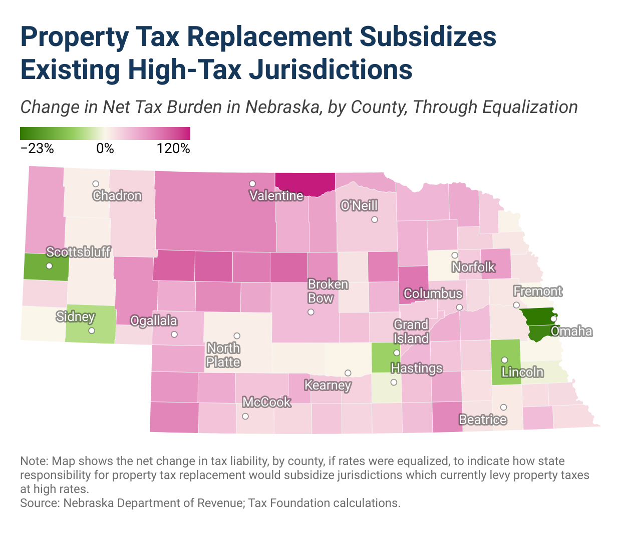

Slide 7
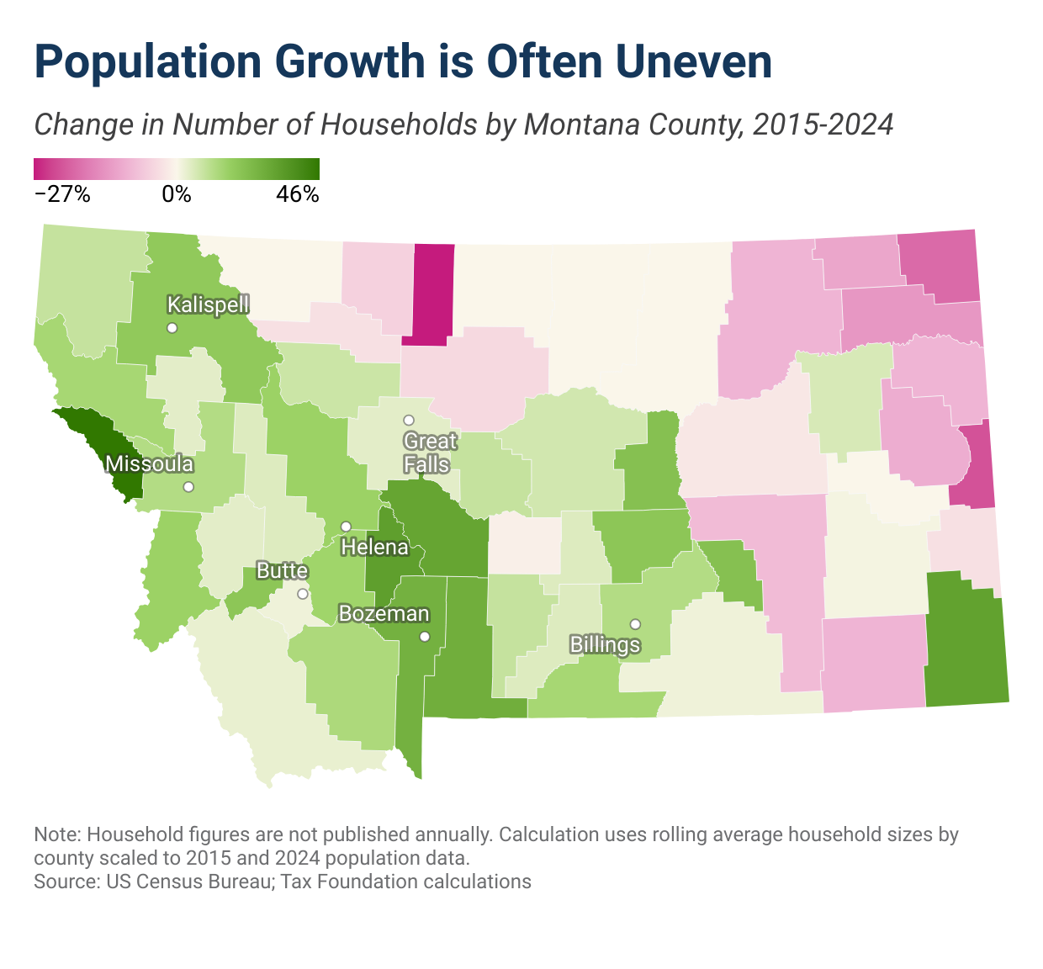

Slide 8
