Slide 1

Estimated Preliminary Impacts of Reappraisal
December 4, 2024
Eric Dale-Tax Policy and Research

Slide 2

Estimated Reappraisal Changes
*Major changes are being made to the valuation and tax rate of forest lands in TY 2025. Market values are decreasing due to new stumpage values and the tax rate is reverting to 0.37% from 0.27%.

Slide 3
How Estimates Compare with Actuals
Residential

Slide 4
How Estimates Compare with Actuals
Commercial

Slide 5
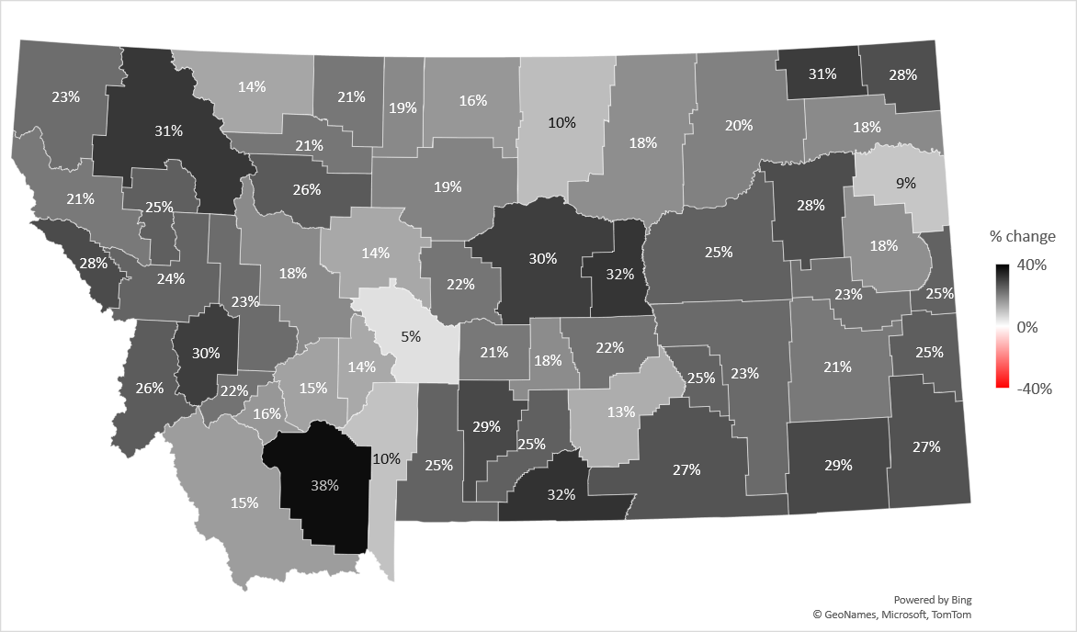
Preliminary Residential Market Value Change

Slide 6
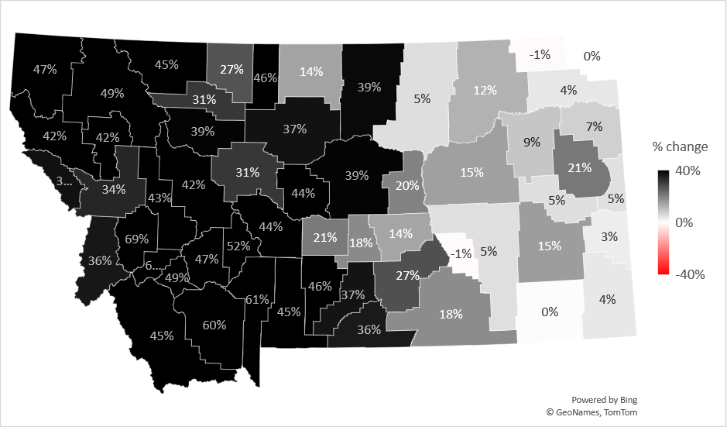
Prior Cycle Residential Market Value Change

Slide 7
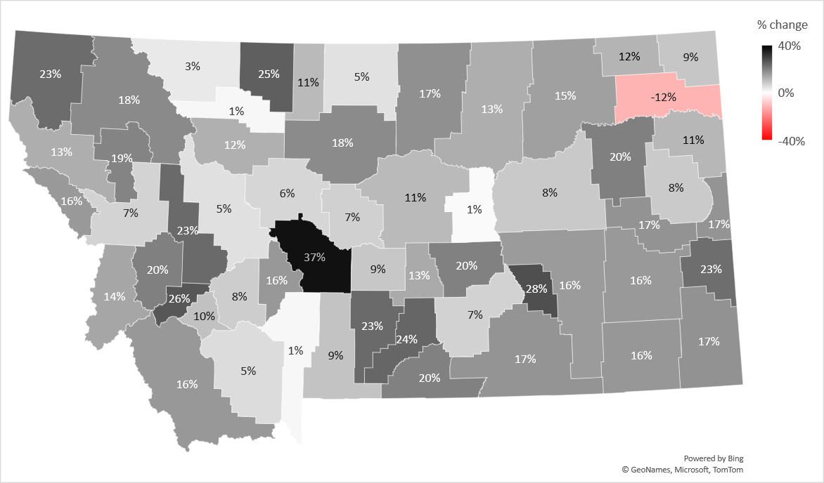
Preliminary Commercial Market Value Change

Slide 8
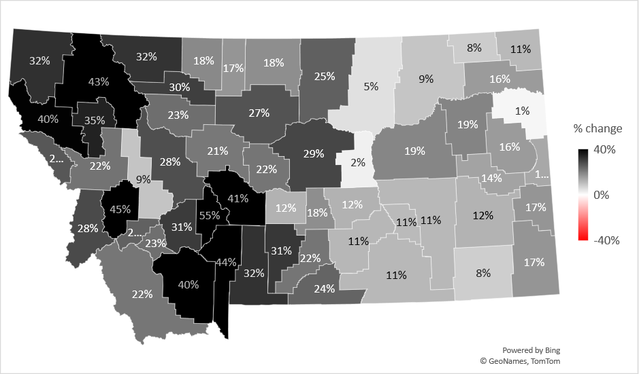
Prior Cycle Commercial Market Value Change

Slide 9
Preliminary Agricultural Market Value Change
Agricultural Market Value Change
Property Class | % change
1101 - Tillable Irrigated Land | 11.81%
1401 - Tillable Non-Irrigated Land/Summer/Fallow | 2.50%
1501 - Tillable, Non-Irrigated, Continuously Cropped | 2.57%
1601 - Grazing Land | 5.05%
1701 - Non-Qualified Ag Land 20-160 Acres | 10.20%
1801 - Wild Hay Land | 11.57%
2001 - 1 Acre Farmstead - Ag 15-7-202(1)(c)(ii), MCA | 16.33%

Slide 10
Preliminary Forest Land Market Value Change
Forest Land Stumpage Value Change
Zone 1 (Northwest) | -23.29%
Zone 2 (Southwest) | -41.39%
Zone 3 (Central) | -28.47%
Zone 4 (East) | 30.57%

Slide 11
Estimated Preliminary Impacts of Reappraisal

Slide 12
Estimated Preliminary Impacts of Reappraisal
Statewide Impact of Reappraisal for Classes 3, 4, and 10
 |  |  | TY 2024 Versus TY 2025 Estimates
 | Property Type |  | Difference-# |  |  |  | Difference-%
 |  |  | TV | Mills | Tax |  | TV | Mills | Tax
 | Res. |  | $605.329 | (41.311) | $154.712 |  | 21.69% | (8.48%) | 11.38%
 | Comm. |  | $52.400 | (38.568) | $3.549 |  | 8.35% | (6.78%) | 0.99%
 | Ag. |  | $8.675 | (26.653) | $0.239 |  | 5.68% | (5.09%) | 0.30%
 | Forest |  | $0.167 | (35.715) | ($0.096) |  | 3.70% | (8.40%) | (5.01%)
 | Other |  | $39.606 | (23.825) | ($9.165) |  | 3.47% | (4.97%) | (1.67%)
 | Total |  | $706.177 | (37.243) | $149.238 |  | 14.97% | (7.49%) | 6.36%

Slide 13




Get social with us!
@MTRevenue
@MTRevenue
@MontanaRevenue
Montana Department of Revenue
Montana Department of Revenue

