Slide 1
The Economic Outlook for the U.S. and Montana
Patrick M. Barkey, Director Bureau of Business and Economic Research University of Montana

Slide 3
The U.S. Economy: Poised to Accelerate?
Forecasts of slow growth have been wrong
Inflation is fading, high prices are not
Fed is moving rates to neutral
Home sales, residential construction in the tank
Manufacturing economy is improving
Worker shortages easing, inventories slowly recovering

Slide 4
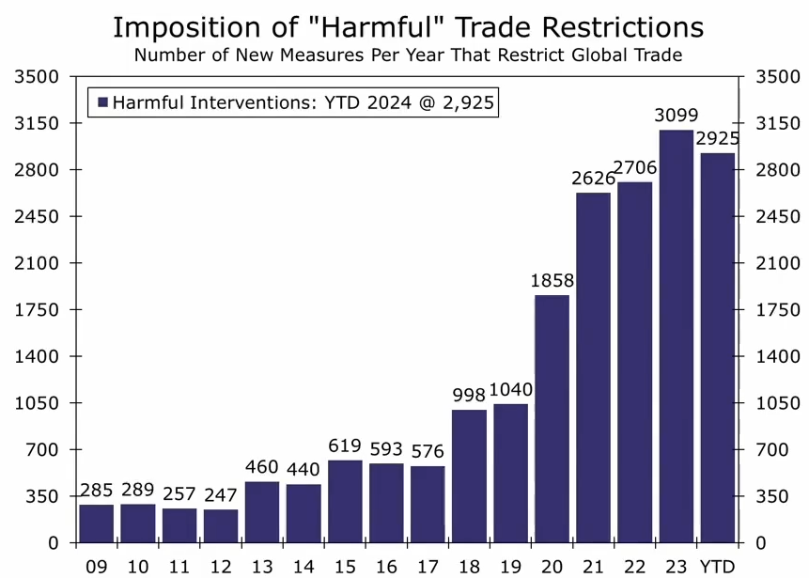

Slide 5
Not Much Growth in the U.S. Forecast Percent Growth, Real Gross Domestic Product, 2023Q3 – 2025Q4
Percent
Forecast
Forecast
2023
2024
2025
Source: S&P Global

Slide 6
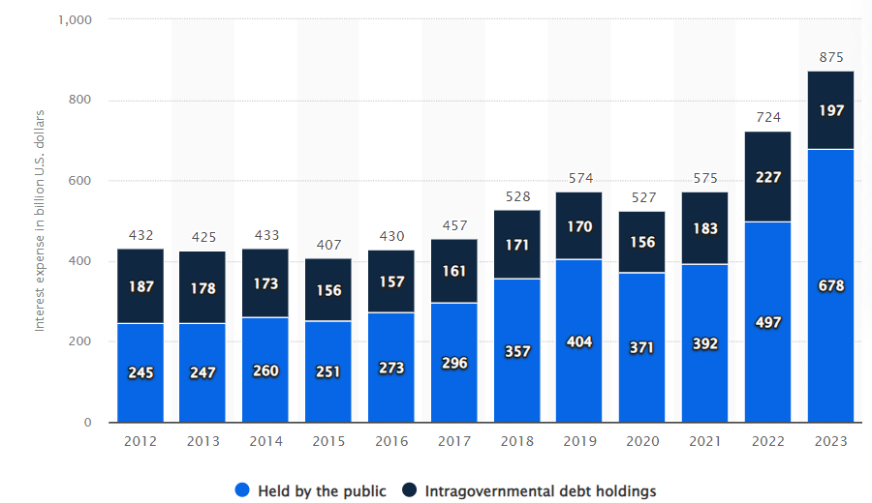
Interest payments on Federal debt now exceed defense spending

Slide 7
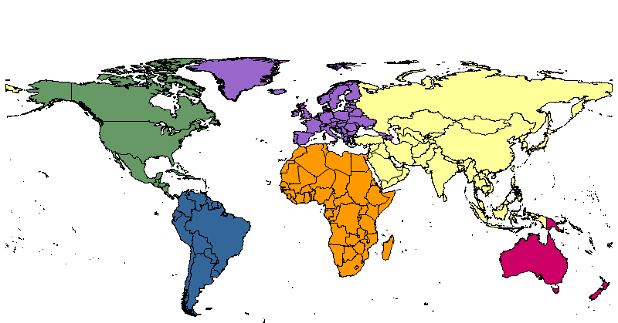
US Outperforms Global Peers in 2024
China
Germany
Russia
5.0%
Canada
3.2%
Japan
0.2%
1.3%
0.7%
United States
2.6%
India
7.0%
Brazil
2.1%
Source: International Monetary Fund

Slide 8
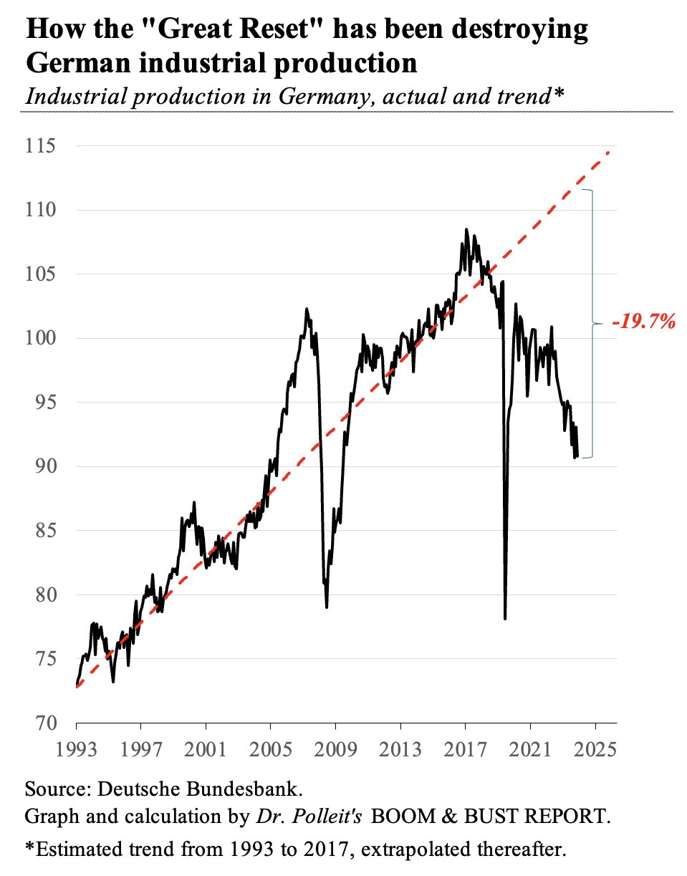
Germany Export-Led Manufacturing Economy is Crashing Industrial Production Index

Slide 9
Montana’s Growth Has Stabilized
Strong visitor year helping offset closures
Lower inflation rates helping wage growth
Tech growth tilting the balance between regions
Sibanye-Stillwater curtailment not yet felt
Interest rate sensitive sectors struggling
Housing remains an unsolved problem

Slide 10
Do you think Montana housing markets need fixing?

Slide 11
Post-2020 Acceleration in Home Prices Was Widespread All Transactions House Price Index, 2014=100
Gallatin
Flathead
Missoula
Silver Bow
Lewis and Clark
Cascade
Yellowstone

Slide 12
Housing Prices in Missoula Are 4x Higher than 1995 Housing Price Index, 1995 = 100
Los Angeles
Missoula
Source: Federal Home Finance Agency

Slide 13
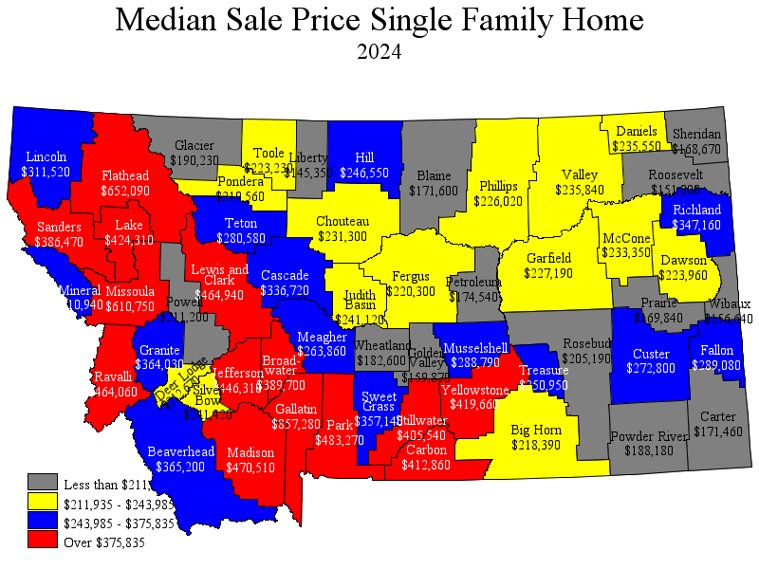

Slide 14
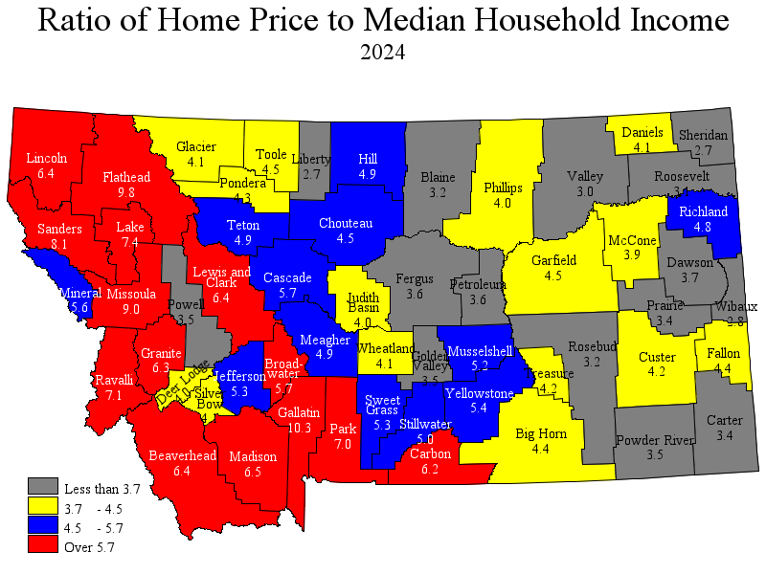

Slide 15
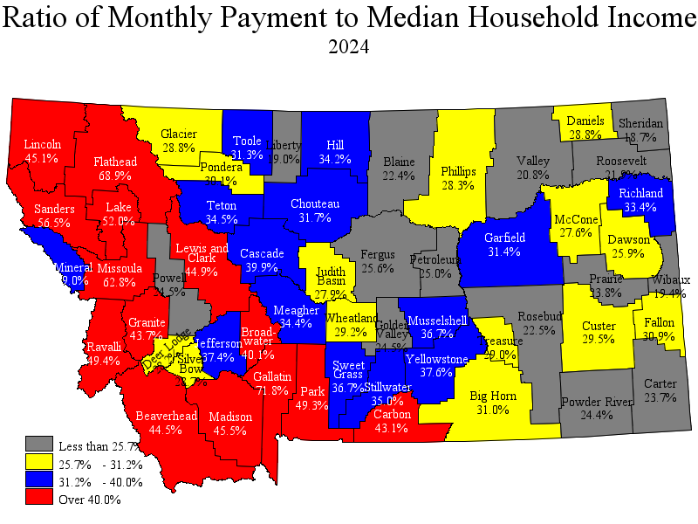

Slide 16
Predicted Point-in-time
People Experiencing Homeless Estimates
70.1
Controls:
County time average
Year average
Change in population
Change in available beds
People
(per 10k
residents)
Portland
Seattle
30.0
Cascade
Missoula
Salt Lake City
Hill
Boise
Silver Bow
Eugene
Richland
Gallatin
Flathead
Roosevelt
Fergus
Yellowstone
7.3
Big Horn
Ravalli
1.8
0.4
Glacier
15%
20%
25%
30%
33%
Median Gross Rent as a Percentage of Income
Sources: BBER Analysis, HUD, U.S. Census

Slide 17
Commodity Prices Tell Different Stories
Materials & Foodstuffs
(as of Oct 2024)
Metals & Energy
(as of Oct 2024)
Low
High
Low
High
586 [Current]
4.32
($ per
Thous. BF)
($ per
Pound)
2.29
4.64
404
1686
1994.22
1069
2.64
($ per
Bushel)
($ per
Ounce)
925
2873
2.13
5.73
1.15
322
1.41
($ per
cwt)
($ per
Pound)
0.86
1.98
149
328
5.37
72.16
($ per
Bushel)
($ per
Barrel)
16.98
114.68
4.29
12.09

Slide 18
Wages and Employment, Montana, 2021Q1 – 2024Q2 Seasonally Adjusted Index, 2021Q1 = 100
Percent
Wages
Employment
2021
2022
2023
2024
Source: U.S. Bureau of Labor Statistics, Quarterly Census of Employment and Wages

Slide 19
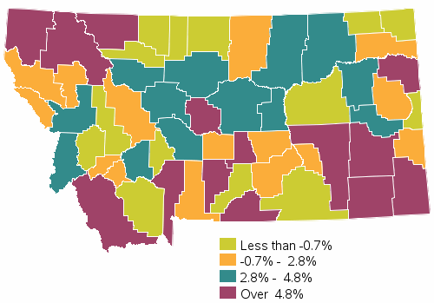
Growth in Total Inflation-Corrected Wages, 2023Q2-2024Q2
Percent

Slide 20
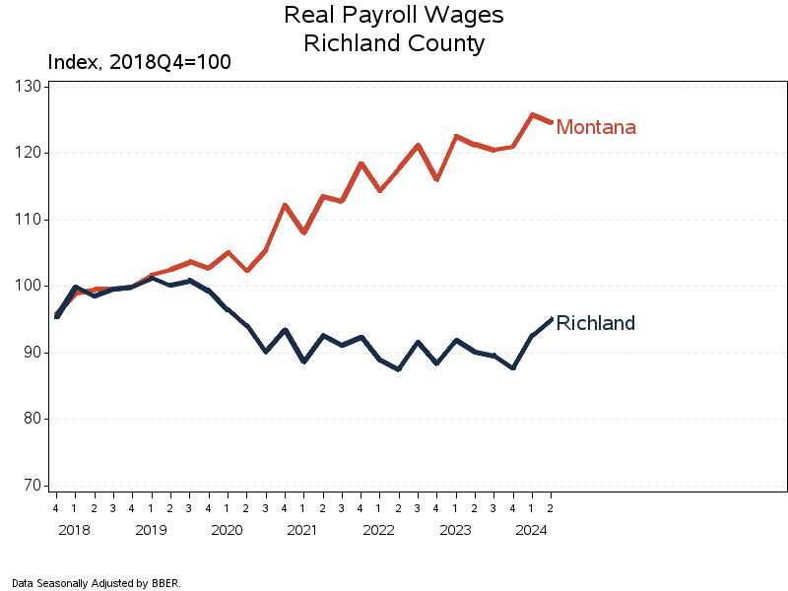

Slide 21
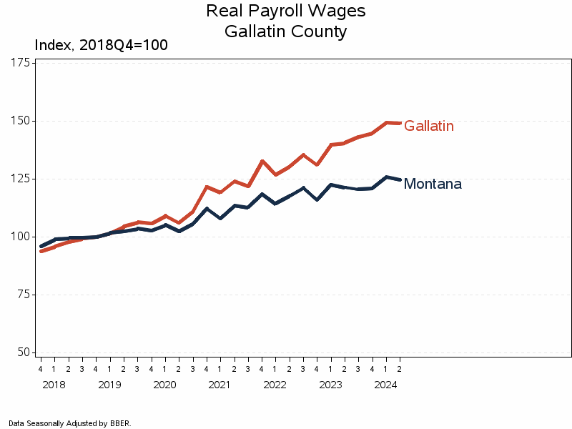

Slide 22
Montana Had More Balanced Growth in FY 2024 Inflation-corrected Total Wage Growth, Montana, $ Millions, 2023-24

Slide 23
Montana Added 6,930 Jobs Last Fiscal Year Seasonally Adjusted Covered Employment, 2018-24
Jobs
Construction: + 385 jobs
Prof & Tech:: + 423 jobs
Health Care: + 1,740 jobs
Public Admin: + 1,185 jobs
2018
2019
2020
2021
2022
2023
2024
Source: U.S. Bureau of Labor Statistics, Quarterly Census of Employment and Wages

Slide 24
Billings Growth Was Underwhelming Inflation-corrected Total Wage Growth, Yellowstone County, $ Millions, FY 2023-24

Slide 25
Tech Growth and Visitors Stood Out in Bozeman Inflation-corrected Total Wage Growth, Gallatin County, $ Millions, 2023-24

Slide 26
Commercial Construction Strong in 2024 Inflation-corrected Total Wage Growth, Lewis & Clark County, $ Millions, 2023-24

Slide 27
Tech and Health Care Led Growth in 2024 Inflation-corrected Total Wage Growth, Missoula County, $ Millions, FY 2023-24

Slide 28
Health Care Resumes Growth in Kalispell in FY 2024 Inflation-corrected Total Wage Growth, Flathead County, $ Millions, 2023-24

Slide 29
Tech and Amenity Counties Outperformed in FY 2024 Inflation-corrected Total Wage Growth, Percent, 2023-24

Slide 30
Montana’s Disappearing Economic Slowdown
Employment, Real Wages and Salary and Real Income Growth, Actual and Forecast, Percent
Source: S&P Global

